Slide 1
Practical 8 - To demonstrate software as a service through google drive​
Name: Zeenat
Roll no: 578
Class: TYIT

Slide 2
AWS Case Study
Introduction:
Amazon Web Services(AWS) is made up of many different cloud computing products and services. The highly profitable division of Amazon provides servers, storage, networking, remote computing, email, mobile development, and security. AWS can be broken into three main products: EC2, Amazon’s virtual machine service, Glacier, a low-cost cloud storage service, and S3, Amazon’s storage system.
AWS is a comprehensive, evolving cloud computing platform provided by Amazon that includes a mixture of infrastructure as a service (IaaS), platform as a service (PaaS) and packaged software as a service (SaaS) offerings. AWS services can offer an organization tools such as compute power, database storage and content delivery services.

Slide 3
AWS has 81 availability zones in which its servers are located. These serviced regions are divided in order to allow users to set geographical limits on their services but also to provide security by diversifying the physical locations in which data is held. Overall, AWS spans 245 countries and territories.
AWS launched in 2006 from the internal infrastructure that Amazon.com built to handle its online retail operations. AWS was one of the first companies to introduce a pay-as-you-go cloud computing model that scales to provide users with compute, storage or throughput as needed.
How AWS works:
AWS is separated into different services; each can be configured in different
ways based on the user's needs. Users should be able to see configuration options
and individual server maps for an AWS service.

Slide 4
1. Amazon Elastic Cloud Compute (EC2)​
​
The Amazon EC2 service comes under the compute domain and it provides services that help to compute workloads
Amazon EC2 offers the broadest and deepest compute platform with choice of processor, storage, networking, operating system, and purchase model.
t is designed to make web-scale cloud computing easier for developers.
Amazon EC2’s simple web service interface allows you to obtain and configure capacity with minimal friction.
Amazon EC2 web interface is used to reduce the expensive physical servers by creating virtual machines.

Slide 5
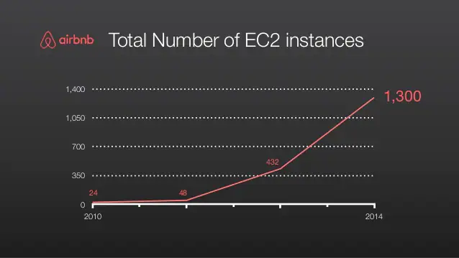
​
6. They help in managing different features of the virtual servers such as security, ports, and storage.​
7. Amazon EC2 is highly preferable while creating a virtual server within a few minutes with just a few clicks according to the user’s operating system conveniently.​
8. It offers resizable compute capacity in the cloud. This helps a lot to focus more on the project rather than the server maintenance.​
9. SAP, HPC, Machine Learning, and Windows workloads run on AWS than any other cloud.​
10. Amazon EC2 offers the broadest and deepest compute platform with choice of processor, storage, networking, operating system, and purchase model.​
​
​

Slide 6
2. Amazon S3 (Simple Storage Service)​
​
Amazon S3 is categorized under storage domain that provides data storage over the Internet services.
S3 is organized into buckets; these are containers of objects that are stored in binary form and can be enriched with attributes Primarily, S3 stores data over the cloud in the form of objects.
Amazon S3 stores the data with high security because of its improved infrastructure.
The information is distributed over different physical regions and has a high-quality integration.
This prevents the data from getting lost and helps to retrieve stored data irrespective of time and space via the Internet.
Amazon S3 is highly available so that users can access their data just by one click with minimum or zero retrieving time.

Slide 7
7. Amazon S3 provides easy-to-use management features so you can organize your data and configure finely-tuned access controls to meet your specific business, organizational, and compliance requirements.
8. Amazon S3 is designed for 99.999999999% (11 9's) of durability, and stores data for millions of applications for companies all around the world.
9. Save costs without sacrificing performance by storing data across the S3 Storage Classes, which support different data access levels at corresponding rates.
10. S3 is the only object storage service that allows you to block public access to
all of your objects at the bucket or the account level with S3 Block Public Access.

Slide 8
3. Amazon Virtual Private Cloud (VPC)​
​
​
Amazon VPC falls under the Networking domain of AWS which is used to isolate the network infrastructure of user’s computer.
Every Amazon account holds a unique virtual network that protects the information from being accessed by others.
These networks are logically isolated from other virtual networks in AWS clouds. This makes the user information risk-free in the AWS cloud.
You have complete control over your virtual networking environment, including selection of your own IP address range, creation of subnets, and configuration of route tables and network gateways.
You can use both IPv4 and IPv6 for most resources in your virtual private cloud, helping to ensure secure and easy access to resources and applications.

Slide 9
6. Amazon VPC lets you to use multiple layers of security, including security groups and network access control lists, to help control access to Amazon EC2 instances in each subnet.
7. Amazon VPC provides advanced security features that allow you to perform inbound and outbound filtering at the instance and subnet level.
8. Amazon VPC's simple set-up, you spend less time setting up, managing, and validating, so you can concentrate on building the applications that run in your VPCs.
9. By using Amazon VPC for disaster recovery, you receive all the benefits of a disaster recovery site at a fraction of the cost.
10. Host a basic web application, such as a blog or simple website, in a VPC and gain the additional layers of privacy and security afforded by Amazon VPC.

Slide 10
4. Amazon CloudFront​
Amazon CloudFront is a web service that speeds up distribution of your static and dynamic web content, such as .html, .css, .js, and image files, to your users.
CloudFront delivers your content through a worldwide network of data centers called edge locations.
If the content is already in the edge location with the lowest latency, CloudFront delivers it immediately.
If the content is not in that edge location, CloudFront retrieves it from an origin that you've defined—such as an Amazon S3 bucket, a MediaPackage channel, or an HTTP server (for example, a web server) that you have identified as the source for the definitive version of your content.
Amazon CloudFront represents the delivery domain that is used to deliver the content with great speed and reduced latency.
Amazon CloudFront is used to connect with other AWS services and to help the developers to send the content to the end-users in a seamless manner.
AWS CloudFront is managing all the users content in an effective manner via the Global Content Delivery Service.

Slide 11
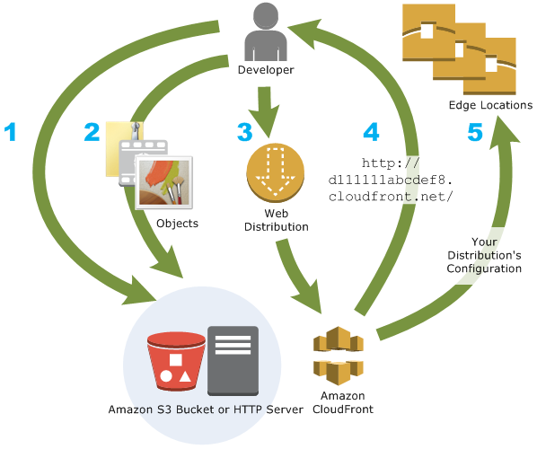
How you set up CloudFront to deliver content
Create a CloudFront distribution to tell CloudFront where you want content to be delivered from, and the details about how to track and manage content delivery. Then CloudFront uses computers—edge servers—that are close to your viewers to deliver that content quickly when someone wants to see it or use it.

Slide 12
5. Amazon Relational Database Services (RDS)​
Amazon Relational Database Service (Amazon RDS) makes it easy to set up, operate, and scale a relational database in the cloud.
Amazon RDS comes under the Database domain of Amazon Web Services and is used to handle database related workloads.
The RDS helps the users to design and manage the relational database in the cloud which stores the complex data of the infrastructure.
Earlier RDs used to support MySQL and now it also supports Oracle, Microsoft SQL, and MariaDB.
It reduces the operational costs and leverages the database server from maintenance and support.

Slide 13
6. It provides cost-efficient and resizable capacity while automating time-consuming administration tasks such as hardware provisioning, database setup, patching and backups.
7. It frees so user can focus on their applications so they can give them the fast performance, high availability, security and compatibility they need.
8. Amazon RDS is available on several database instance types - optimized for memory, performance or I/O .
9. It provides six familiar database engines to choose from, including Amazon Aurora, PostgreSQL, MySQL, MariaDB, Oracle Database, and SQL Server.
10. Use the AWS Database Migration Service to easily migrate or replicate existing databases to Amazon RDS.

Slide 14
Thank you !

